Slide 1


Predict Customer Personality to boost marketing campaign by using Machine Learning
Created by:
Fairuz Nur Indah Putri
fnputri31@gmail.com
https://www.linkedin.com/in/fairuz-nur-indah-p/
An Engineering Graduate that highly motivated about learning new things to improve my skills, especially in machine learning, quantitative analytics, and statistics. I am currently interested in working in the data field, especially being a data scientist. I have experience in using Python, R, and SQL and have several machine learning projects that I have worked on including supervised, unsupervised, product recommendation, forecasting, and deep learning with tensorflow.

Slide 2
Overview
“Sebuah perusahaan dapat berkembang dengan pesat saat mengetahui perilaku customer personality nya, sehingga dapat memberikan layanan serta manfaat lebih baik kepada customers yang berpotensi menjadi loyal customers. Dengan mengolah data historical marketing campaign guna menaikkan performa dan menyasar customers yang tepat agar dapat bertransaksi di platform perusahaan, dari insight data tersebut fokus kita adalah membuat sebuah model prediksi kluster sehingga memudahkan perusahaan dalam membuat keputusan ”

Slide 3
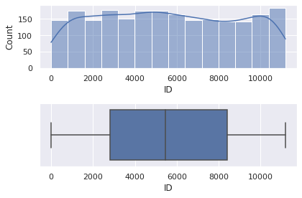
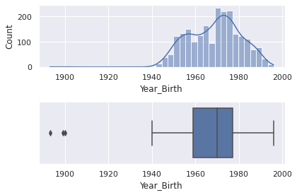
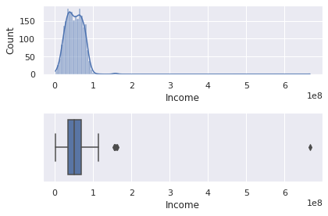
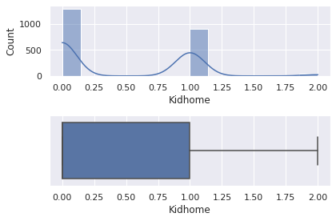

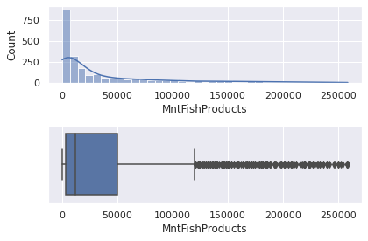
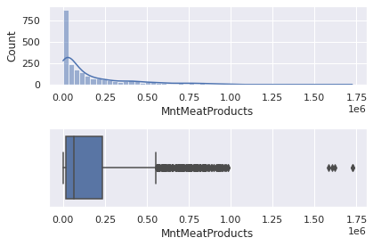
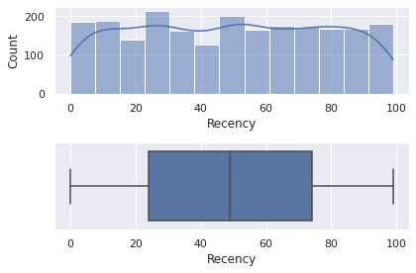
Conversion Rate Analysis Based on Income, Spending and Age
EDA (Numeric Columns)
Untuk selengkapnya, dapat melihat jupyter notebook disini

Slide 4
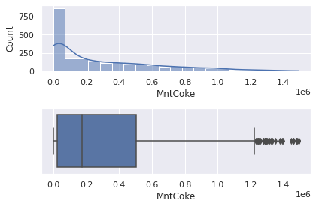
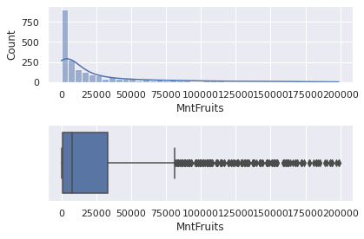
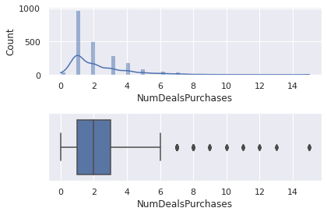
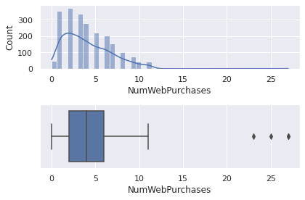
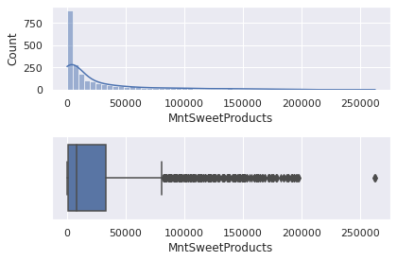
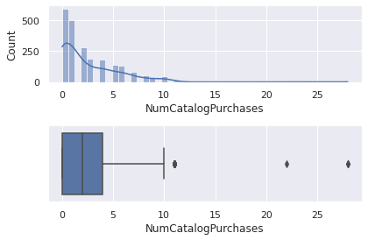
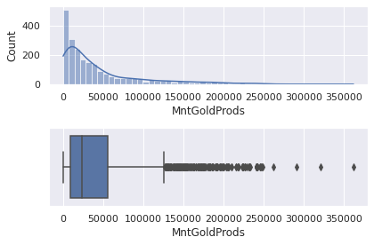
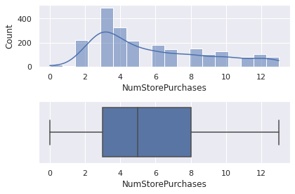
Conversion Rate Analysis Based on Income, Spending and Age
EDA (Numeric Columns)
Untuk selengkapnya, dapat melihat jupyter notebook disini

Slide 5
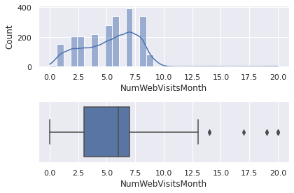
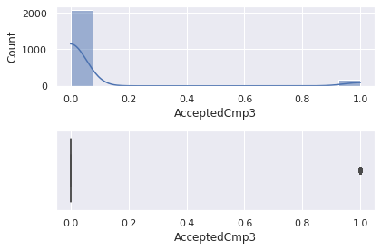



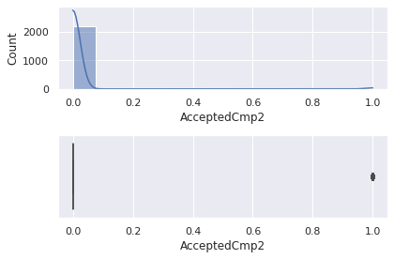
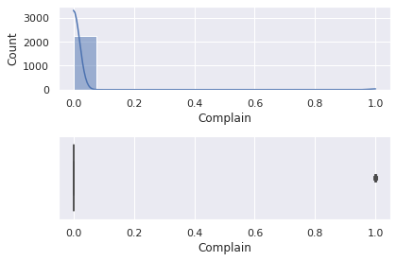
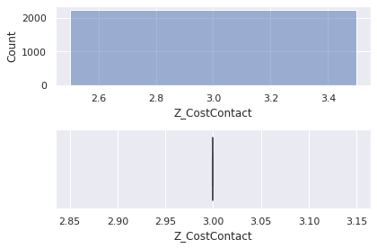
Conversion Rate Analysis Based on Income, Spending and Age
EDA (Numeric Columns)
Untuk selengkapnya, dapat melihat jupyter notebook disini

Slide 6
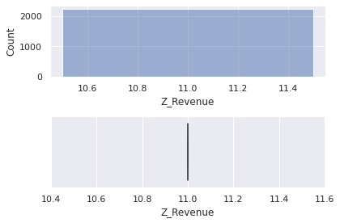
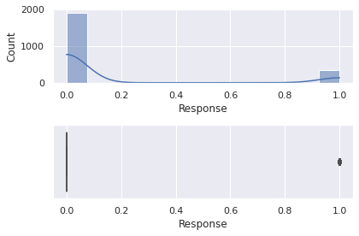
Conversion Rate Analysis Based on Income, Spending and Age
EDA (Numeric Columns)
Untuk selengkapnya, dapat melihat jupyter notebook disini

Slide 7
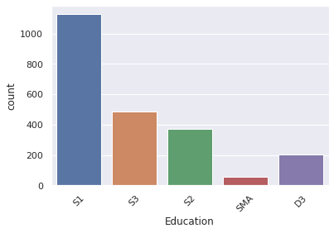
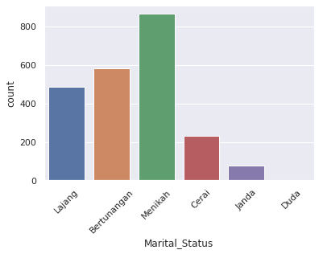
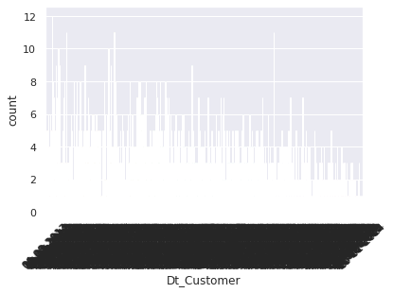
Conversion Rate Analysis Based on Income, Spending and Age
EDA (Category Columns)
Untuk selengkapnya, dapat melihat jupyter notebook disini

Slide 8
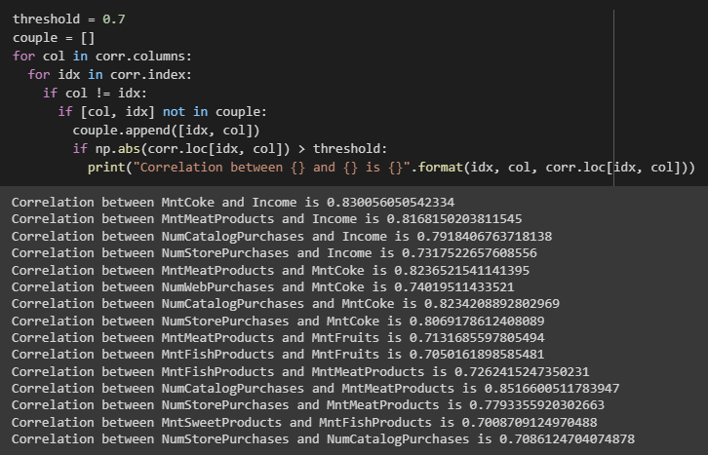
Conversion Rate Analysis Based on Income, Spending and Age
EDA (Correlation)
Untuk selengkapnya, dapat melihat jupyter notebook disini

Slide 9
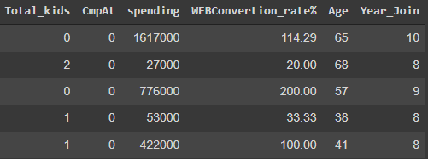
Conversion Rate Analysis Based on Income, Spending and Age
2. Data Preparation
Several columns resulting from feature extraction : Total_kids, spending, WEBConvertion_rate%, Age, Year_Join
Total_kids = Kidhome + Teenhome
cmpAt = customer accepted at which campaign (scale 1 – 5, there are 5 campaign)
spending = MntCoke + MntFruits + MntMeatProducts + MntFishProducts + MntSweetProducts + MntGoldProds
WEBConvertion_rate% = (NumWebPurchases / NumWebVisitsMonth) * 100
Age = date.today().year – Year_Birth
Year_Join = date.today().year - Dt_Customer
Untuk selengkapnya, dapat melihat jupyter notebook disini

Slide 10
Conversion Rate Analysis Based on Income, Spending and Age
2. Data Preparation
Change and merge Janda and Duda value with Cerai
Untuk selengkapnya, dapat melihat jupyter notebook disini

Slide 11
Conversion Rate Analysis Based on Income, Spending and Age
Impute Missing Value – Simple Imputer
Encoding – One Hot Encoding
Scaling – Robust Scaler
3. Feature Engineering
Untuk selengkapnya, dapat melihat jupyter notebook disini

Slide 12
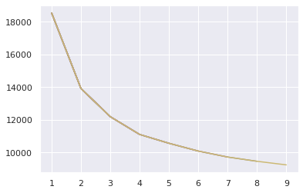
Conversion Rate Analysis Based on Income, Spending and Age
Elbow Method
Based on elbow method result, I choose 3 for the k because after looking forward through the model k = 3 gives good cluster.

Slide 13
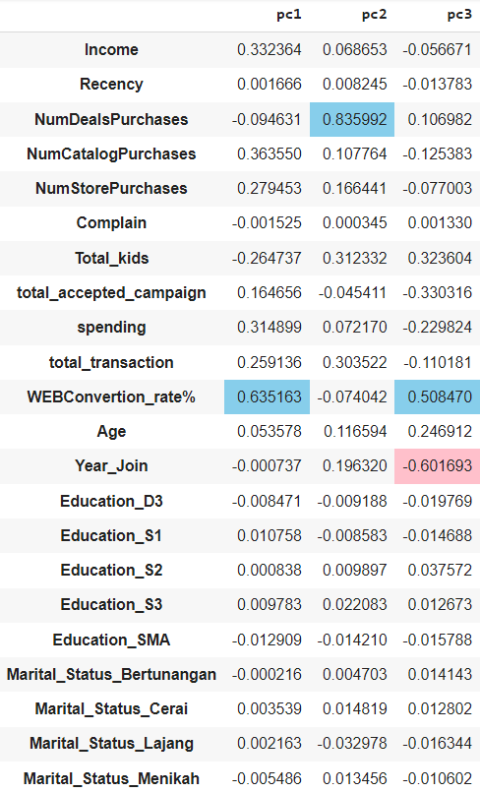
Conversion Rate Analysis Based on Income, Spending and Age
Modeling (With PCA)
After fit and transform the model with PCA using data after feature engineering. We can get the pca component with pca.components_, and according to the picture beside we can see all features that more dominant and representative to the PC.
WebConvertion_rate% represent pc1 with pca component score 0.635
NumDealsPurchaces represent pc2 with pca component score 0.835.
WebConvertion_rate% and Year_Join represent pc3 with pca component score 0.508 and -0.601. I choose Year_Join because it more represent to the pc3. Minus means different direction.

Slide 14
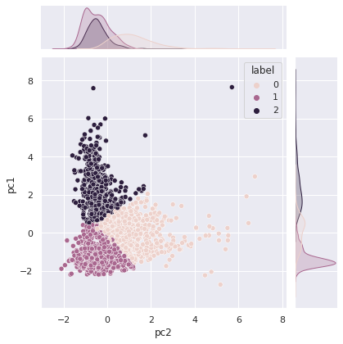
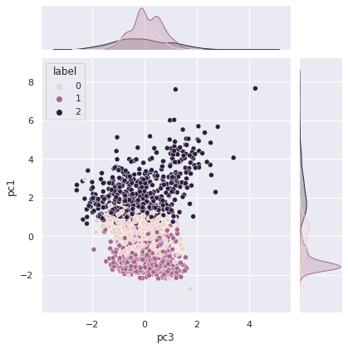
Conversion Rate Analysis Based on Income, Spending and Age
1. Modeling (With PCA)
Clustering result
Pc1(WebConversion_rate%): label 1 is distributed in the low value, label 0 in the middle value, and label 2 in the high value.
Pc2(NumDealsPurchaces): label 0 is distributed in the middle value, label 1 is distributed in the low value and label 2 is distributed in the high value.
In addition, label 2 has a high standard deviation because the distribution is spread when viewed on labels pc1 and pc2.
Pc3 (Year_Join): label 0 is distributed in the middle value of pc2 and high value of pc1, label 1 is distributed in the low value of pc1 and pc2, label 2 is distributed in the high value of pc1 and low value of pc2.

Slide 15
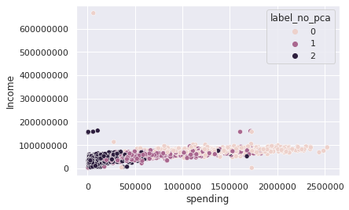
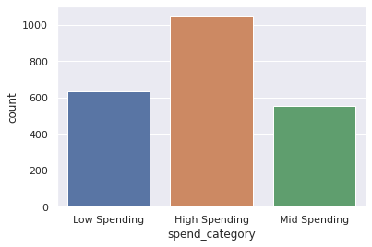
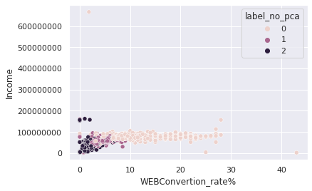
Conversion Rate Analysis Based on Income, Spending and Age
2. Modeling (Without PCA)
Clustering result based on Income, Spending, and Age
Based on the relationship between income and spending, web conversion rate and income are determined by three clusters, namely:
Label 0 = High Spender
Label 1 = Mid Spender
Label 2 = Low Spender

Slide 16
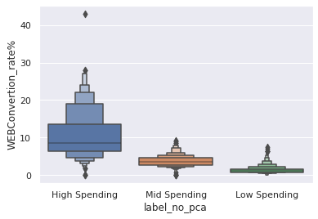
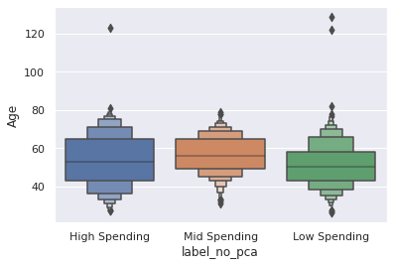
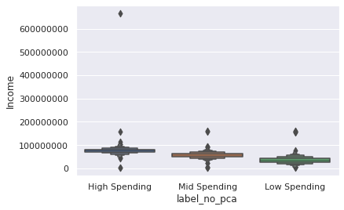
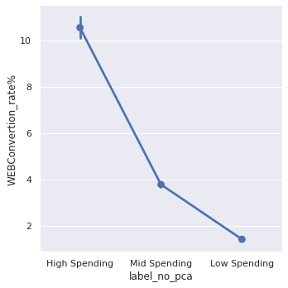
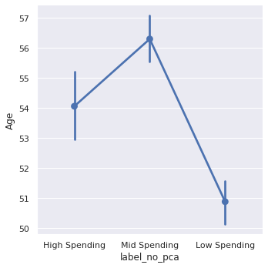
Conversion Rate Analysis Based on Income, Spending and Age
2. Modeling Without PCA (Web Convertion Rate (%), Age, Income per cluster)

Slide 17
Conversion Rate Analysis Based on Income, Spending and Age
1. Low Spender:
This category is dominated by customers aged 43 - 55 years with the youngest age being 26 years. The Web conversion rate is between 0.83 - 1.71. The average income in this group is IDR 34,000,000.
2. Mid Spender:
This category is dominated by customers aged between 49-65 years, with the youngest age being 31 years. Wrb conversion rate in this group is between 2.60 - 4.7. The average income in this group is IDR 57,000,000 with a maximum value of IDR 160,800,000.
3. High Spender
This category is dominated by customers aged between 40 - 65 years, with the youngest age being 27 years old. The web convertion rate in this group is between 6.3 - 13.3 with the highest value is 43. The average income in this group is IDR 76,000,000 with a Q3 value of IDR 83,000,000 and the maximum value including outliers is IDR 600,000,000.

Slide 18
Conversion Rate Analysis Based on Income, Spending and Age
Bussines Recomendation
Continue to monitor transactions and retention of the High Spender group, Focus on improving service so that this group does not churn
For the Mid Spender group, further analysis can be carried out on how to increase their transactions by providing more personalized recommendations, as well as deeper analysis on how to optimize promos in this segment and keep shopping on our platform.
For the Low Spender group, further analysis can be carried out on how to increase the visit to transaction conversion ratio. They have a fairly high number of visits but do not make transactions. This can be caused by products or prices that do not match.

